Slide 1
Computer Organization and Assembly Fall 2019
Lecture 20
Syeda Farwa Batool

Slide 2
Hardware Interrupts
Interrupts those occur by any hardware is called hardware interrupt.
However there is a single pin outside the processor called the INT pin that is used by external hardware to generate interrupts.
We need more than one pins because we have more than 1 hardware devices.

Slide 3
PIC
Since there are many devices generating interrupts and there is only one pin going inside the processor and one pin cannot be technically derived by more than one source a controller is used in between called the Programmable Interrupt Controller (PIC).
PIC has 8 input (means 8 hardware devices are connected)and one output pin (means at a time interrupt of one hardware device will be entertain)
The eight input signals to the PIC are called Interrupt Requests (IRQ).

Slide 4
8 IQRs
IQR 0 for timer
IQR 1 for keyboard (press and released two interrupts)
IQR 2 for connecting output of second PCI
IQR 3 is connected to serial port COM 2
IQR 4 is connected to serial port COM 1
IQR 5 is connected sound card or network card (IQR conflict can occur)
IQR 6 floppy disk drive
IQR 7 is connected with parallel port

Slide 5
IQRs to Interrupts
IQR 0 to IQR 7 are mapped on different interrupts
IQR | Interrupt No
IQR 0 | int 8
IQR 1 | int 9
IQR 2 | int A
IQR 3 | int B
IQR 4 | int C
IQR 5 | int D
IQR 6 | int E
IQR 7 | int F
Priority
Notes:
The actual
mechanism fetches one instruction from the PIC whenever the INT pin is
signaled instead of the memory. We can program the PIC to generate a
different set of interrupts on the same interrupt requests.

Slide 6
EOI (End of interrupt)
At the end of servicing the interrupt the handler should inform the PIC that it is completed so that lower priority interrupts can be sent from the PIC. This signal is called an End Of Interrupt (EOI) signal and is sent through the I/O ports of the interrupt controller.
Code value of EOI is 0x20
We send this value to PIC port.

Slide 7
I/O PORTS
There are hundreds of peripheral devices in the system, PIC is one example.
The processor needs to communicate with them, give and take data from them, otherwise their presence is meaningless.
Memory has a totally different purpose. It contains the program to be executed and its data. It does not control any hardware.
For communicating with peripheral devices the processor uses I/O ports.

Slide 8
In/Out
In command is use to read data from a port
Out command is use to write data on a port
in al, 0x21
mov dx, 0x378
in al, dx
out 0x21, al
mov dx, 0x378
out dx, al

Slide 9
Some ports
20 and 21 are for PIC
60 to 64 for Keyboard,
378 for the parallel port

Slide 10
PIC mask register
Each of the bits at port 21 corresponds to one of the IRQ lines.
disable keyboard interrupt in PIC mask register
[org 0x0100]
in al, 0x21 ; read interrupt mask register
or al, 2 ; set bit for IRQ2
out 0x21, al ; write back mask register
mov ax, 0x4c00 ; terminate program
int 0x21

Slide 11
Complete Flow of a HD interrupt
Hardware Device interrupt or send data
Program is running normally
Program Stops
Data of Hardware device is
written on its associated port
A signal for (0-7 IQR) input pins of PIC
An interrupt is called for corresponding IQR
Interrupt read data from associated port and send to processor
EOI (end of interrupt is called and control is send back to PIC

Slide 12
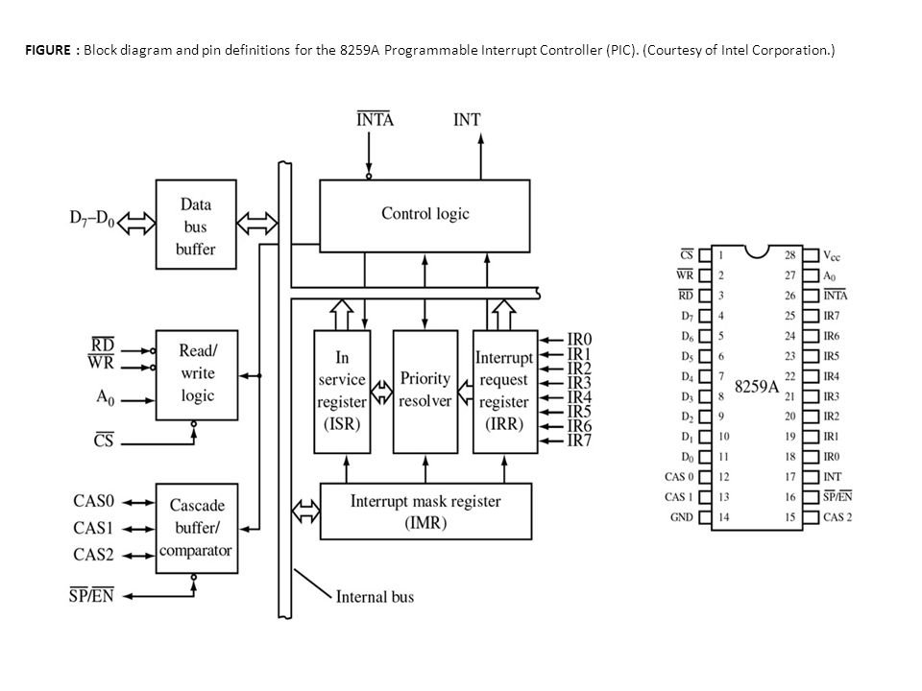
Notes:
https://www.google.com/url?sa=i&source=images&cd=&ved=2ahUKEwiRzqC8ic7lAhUNY1AKHRqFADQQjRx6BAgBEAQ&url=%2Furl%3Fsa%3Di%26source%3Dimages%26cd%3D%26ved%3D2ahUKEwiW6dCiic7lAhVJJVAKHbvXCVsQjRx6BAgBEAQ%26url%3Dhttps%253A%252F%252Fslideplayer.com%252Fslide%252F9230440%252F%26psig%3DAOvVaw1kyXqDm7dCpGGxgAvmLnuW%26ust%3D1572871529407617&psig=AOvVaw1kyXqDm7dCpGGxgAvmLnuW&ust=1572871529407617

Slide 13
differentiate left and right shift keys with scan codes
[org 0x0100]
jmp start
start:
xor ax, ax
mov es, ax ; point es to IVT base
cli ; disable interrupts
mov word [es:9*4], kbisr ; store offset at n*4
mov [es:9*4+2], cs ; store segment at n*4+2
sti
l1: jmp l1 ; infinite loop

Slide 14
; keyboard interrupt service routine
kbisr:
push ax
push es
mov ax, 0xb800
mov es, ax ; point es to video memory
in al, 0x60 ; read a char from keyboard port
cmp al, 0x2a ; is the key left shift
jne nextcmp ; no, try next comparison
mov byte [es:0], 'L' ; yes, print L at top left
jmp nomatch ; leave interrupt routine
nextcmp: cmp al, 0x36 ; is the key right shift
jne nomatch ; no, leave interrupt routine
mov byte [es:0], 'R' ; yes, print R at top left
nomatch:
mov al, 0x20
out 0x20, al ; send EOI to PIC
pop es
pop ax
iret

